Slide 1
Opera Villaggio del Fanciullo
Trieste Italy
Massimo Tierno
m.tierno@villaggioformazione.org

Slide 2
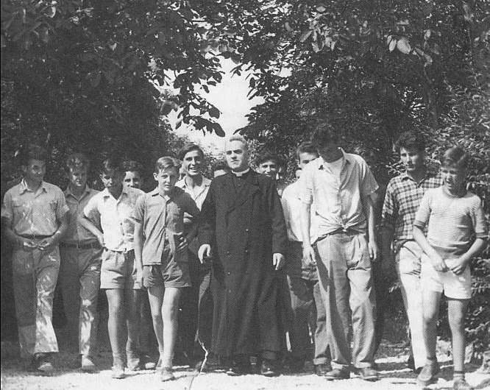
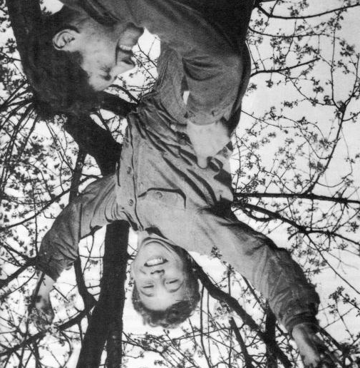
The Villaggio del Fanciullo was born in 1949, thanks to the support of the Allied Military Government. It was founded with the aim of provide hospitality to young orphans and refugees of the Second World War and ensure their social integration through vocational training.
History

Slide 3
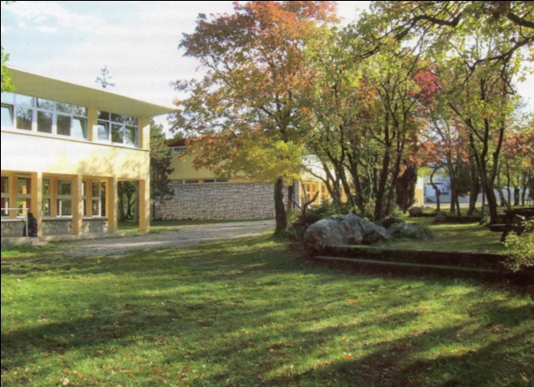
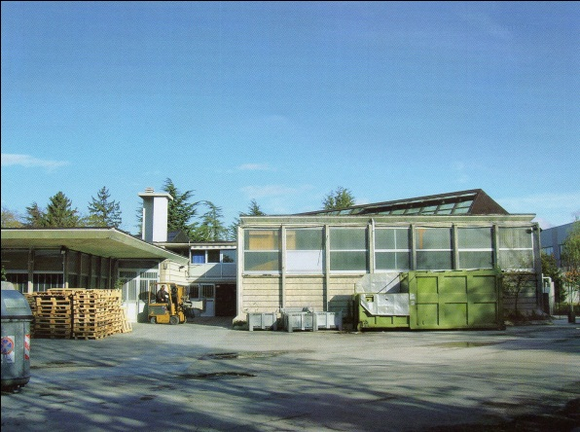
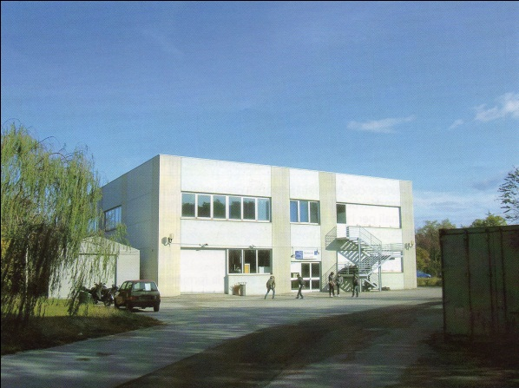
Since its foundation the Opera Villaggio del Fanciullo is composed of three realities
Hospitality
Production
Educational and Vocational training

Slide 4
The campus
In its 9300 m² campus, the Villaggio del Fanciullo hosts:
12 buildings,
one sport center,
two tennis courts,
one soccer field,
3 basketball courts,
The International School of Trieste,
94 employees.
The Campus

Slide 5
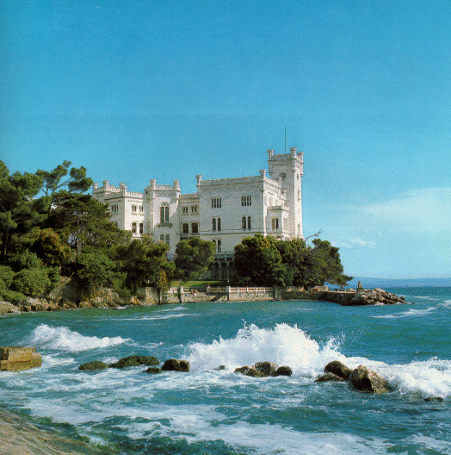
Stakeholders
In the Friuli Venezia Giulia Region are:
Companies,
Public and private social associations,
Schools and training centers
Social host communities
Ministry of Justice
Prison of Trieste
FVG Region

Slide 6
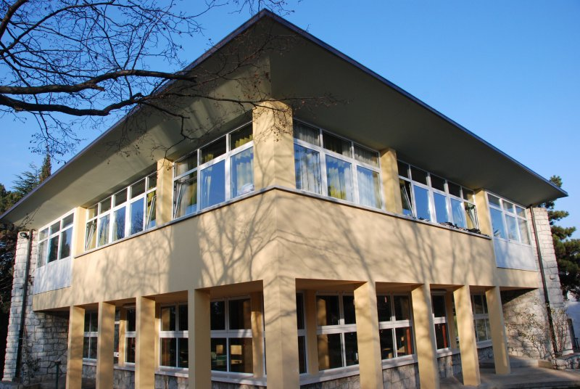
Educational Community
The Educational Community of the “Opera Villaggio del Fanciullo” hosts adolescents and young adult males, aged between 12 and 21 years, who are in distress and deviance:
children who come from difficult family situations,
minors under civil proceedings issued by the Juvenile Court and handed over to Social Services,
children who come from the phenomenon of illegal immigration,
juvenile offenders for whom it is prescribed by the Juvenile Court placement in community.

Slide 7
Typography Enterprise
The Typography Enterprise of the “Opera Villaggio del Fanciullo”.
The technology:
The main activity is based on sheet-fed offset printing press. The unique press in the Friuli Venezia Giulia Region for printing on coated paper. The packaging lines are a staple and allow us to work booklets, shrink-wrap and single-copy mailing.
The customers: The most important customers are: the University of Trieste, the Friuli Venezia Giulia Region, the Ministry of Foreign Affairs, the Superintendency of Fine Arts, two regional newspapers and also the diocesan weekly “Vita Nuova".
The team:
Include a graphic layout artists group that can meet any customer need.

Slide 8
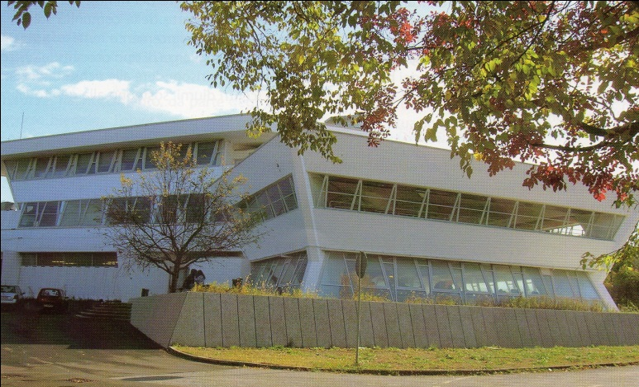
Educational and Vocational Training Center
The Vocational Training Center of the “Opera Villaggio del Fanciullo” has modern structures and innovative equipment in order to ensure training in step with the times. The sectors in which it carries out its educational activities are mainly the graphics, printing, mechanics, catering and information technology.

Slide 9
Educational and Vocational Training Center
We have a wide range of training courses such as:
three-year courses of qualification,
professional training courses for adults,
languages evening classes​​,
ECDL information technology courses,
italian courses for foreigners,
work experience grants,
professional courses for young people with disabilities,
long life learning programe.
Furthermore, each year we create a special project, this year is the turn of "Bread & bar" that provides a professional training course on baking to adult offenders of the Trieste Prison.

Slide 10
Educational and Vocational Training Center
CFP makes vocational training a force to develop total existence of a person though active participation and solidarity in the community.
CFP is committed to educate through responsibility and mutual respect. Collaborations with organizations such as Aluscuola and Italian Technical Association for the Development of Flexo allows us to improve the quality of training, through updating of our teaching staff and the introduction of new technologies,
We help them to play their trump card

Slide 11
Educational and Vocational Training Center
The CFP has invested in renewable energy, promoting a post-graduate course for installers of photovoltaic panels. This initiative stems from the agreement with the major players in the field of sustainable development.
An investment for the future

Slide 12
Thank you
Massimo Tierno
m.tierno@villaggioformazione.org

